Slide 1
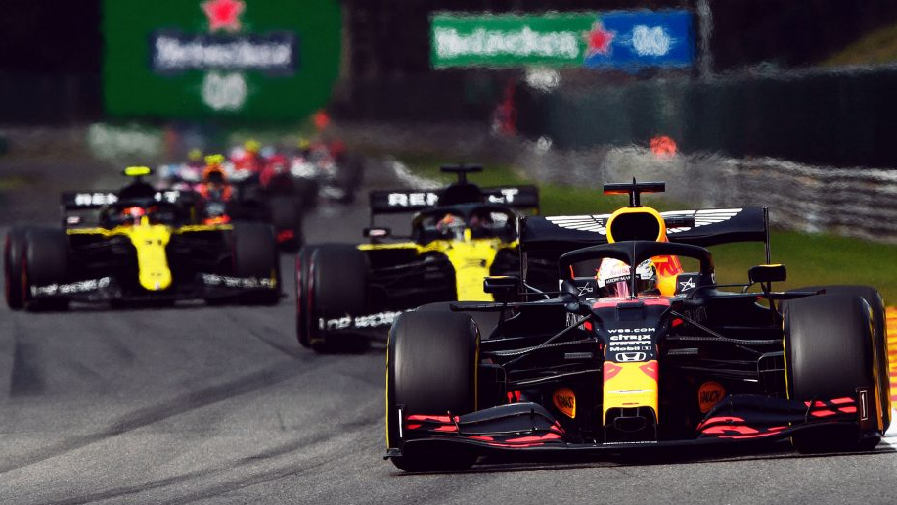
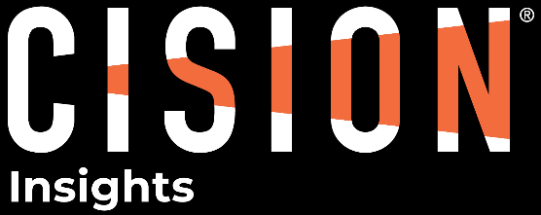
2021 ZANDVOORT GRAND PRIX
Social & Traditional Media Insights

Slide 2
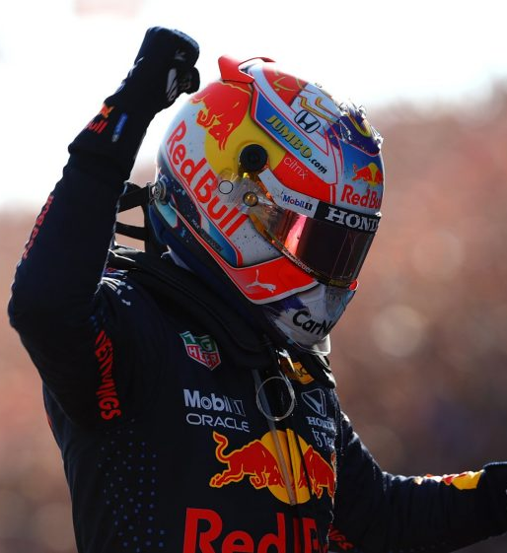

Management Summary
Max Verstappen’s victory at home in Zandvoort’s first Grand Prix since the 1980s brings a highly positive reaction from fans and media. On social media, positive sentiment is up 12 percentage points vs. the season average and the leading emotional response is Joy.
In terms of visibility, the race ranks 5th in traditional media and 8th on social media. Social reaction is limited due to a lack of incidents during the race itself and few overtakes. Most reaction from fans (60%) comes after the race finish and focusses on the result rather than the racing itself. The exciting “carnival atmosphere” in the stands is one of the race’s most visible talking points.
Mercedes fan reaction is mixed, with some lamenting the team’s strategy decisions, some criticising the race itself for delivering “boring” racing, and some celebrating a solid result for the team. In contrast, Red Bull fans are unified in Joy at Verstappen’s victory and lead in the Drivers’ Championship.
Aside from Red Bull and Mercedes, Ferrari receives significant visibility from its large fanbase on social media, while Pierre Gasly and Sergio Perez also feature prominently in discussion thanks to impressive results from both drivers.
The majority of news articles shared to social media were posted to Facebook, while Twitter hosted the majority of social discussion and reaction to the race. Japan produced the highest visibility at a market level, followed by the UK, USA and the Netherlands.
Pirelli was the most visible partner in traditional media, while Heineken was dominant on social channels, thanks to a collaborative afterparty event with the Red Bull team.
11.8k | Traditional Posts
246k | Social Mentions
Verstappen
Heineken
Most Visible Driver
Most Visible Partner
Timeframe: 01/03/2021 – 07/09/2021 | Sentiment & Emotional Response powered by automated analysis
Scope: Social Media (Twitter, Reddit, Forums, Tumblr) powered by Brandwatch. Traditional (Earned) Media (Online, Blogs, TV) powered by Cision Comms Cloud | “Superfan” Audience: Users with teams/drivers specifically mentioned in their profile bios – excludes organisations and journalists

Slide 3
F1 Season to Date
The Zandvoort Grand Prix is the 8th most visible race on social media and the 5th most visible in traditional media so far this season
At Zandvoort, positive sentiment on social is significantly above average (+12pp), with Verstappen’s home victory contributing to significant positive reaction from fans
As a whole, rection to the season so far has been positive on social platforms, with joy the leading emotional response in social conversation
Traditional Visibility | 1.6M | Traditional Sentiment |  | Social Visibility | 18.0M | Social Sentiment |  | Emotion
Bahrain Testing
Bahrain GP
Italy GP
Portugal GP
Spain GP
Monaco GP
Azerbaijan GP
France GP
Steier-mark GP
Austria GP
Great Britain GP
Hungary GP
Belgium GP
Nether-lands GP
Timeframe: 01/03/2021 – 07/09/2021 | Sentiment & Emotional Response powered by automated analysis
Scope: Social Media (Twitter, Reddit, Forums, Tumblr) powered by Brandwatch. Traditional (Earned) Media (Online, Blogs, TV) powered by Cision Comms Cloud | “Superfan” Audience: Users with teams/drivers specifically mentioned in their profile bios – excludes organisations and journalists

Slide 4
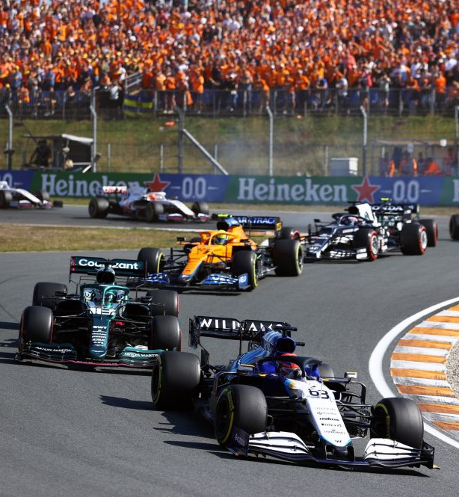
Race By Race Comparison
 | Traditional Visibility | Social Visibility | Emotion
Hungaroring | 15.9k | 543k
Silverstone | 17.1k | 451k
Baku | 12.6k | 390k
Bahrain | 12.6k | 320k
Monaco | 13.0k | 295k
Zandvoort | 11.8k | 246k
Ocon wins his first race; 5-car crash in turn 1 leads to exciting, open racing with many Hamilton overtakes
Hamilton-Verstappen collision in Lap 1 leads to Max’s early retirement & victory for Lewis
Tyre malfunctions for Stroll & Verstappen; Hamilton crash after restart; Perez second win
Hamilton victory after intense final five laps closely pursued by Verstappen
Monégasque Charles Leclerc retires before race start with gearbox issues after qualifying on pole
Dutch driver Verstappen wins in front of a packed crowd in the Netherlands’ first Grand Prix since 1985
Timeframe: 01/03/2021 – 07/09/2021 | Sentiment & Emotional Response powered by automated analysis
Scope: Social Media (Twitter, Reddit, Forums, Tumblr) powered by Brandwatch. Traditional (Earned) Media (Online, Blogs, TV) powered by Cision Comms Cloud | “Superfan” Audience: Users with teams/drivers specifically mentioned in their profile bios – excludes organisations and journalists

Slide 5

Zandvoort in Focus
11.8k TRADITIONAL MENTIONS |  | 33% Positive
 |  | 14% Negative
246k SOCIAL MENTIONS |  | 36% Positive
 |  | 12% Negative
TOP MARKETS (MENTIONS)
TOP INFLUENCERS (REACH)
KEY MOMENT
LAP 72: HOME VICTORY
At the end of a strategy-focussed race with few overtakes, the result itself was the standout topic of discussion on social channels. Verstappen’s victory pushed him above Hamilton in the Driver’s Championship, solidifying what many have seen as a dominant performance this season.
A packed crowd of orange-clad Dutch fans cheering for Verstappen brought what journalists describe as a “carnival atmosphere” to Zandwoort, in contrast to what many fans on social called a “boring” race.
AUDIENCE RESPONSE OVER TIME
44k SOCIAL MENTIONS | 18% OF ALL SOCIAL DISCUSSION
Timeframe: 05/09/2021 (Race Day Only) | Sentiment & Emotional Response powered by automated analysis
Scope: Social Media (Twitter, Reddit, Forums, Tumblr) powered by Brandwatch. Traditional (Earned) Media (Online, Blogs, TV) powered by Cision Comms Cloud | “Superfan” Audience: Users with teams/drivers specifically mentioned in their profile bios – excludes organisations and journalists

Slide 6
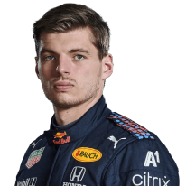
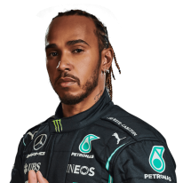
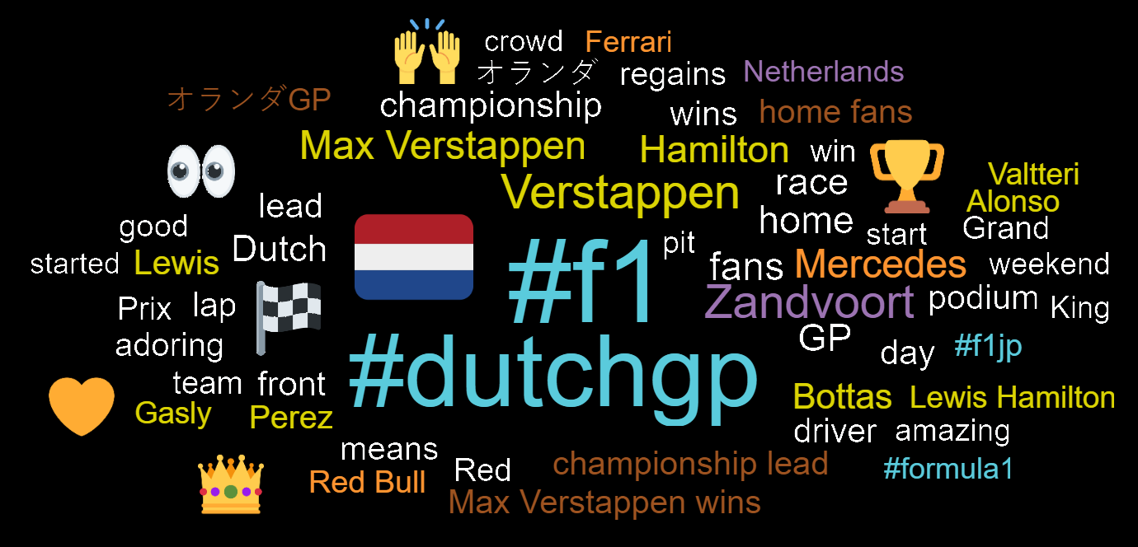
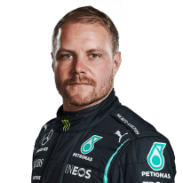
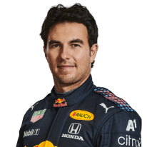
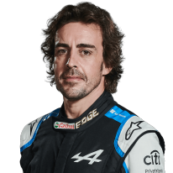
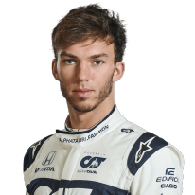
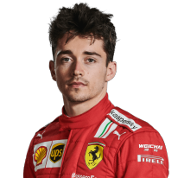
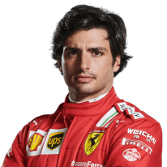
Trending Topics | Zandvoort GP
Verstappen is by far the most visible driver on social channels, with his home victory being the most prominent topic overall. Hamilton and Bottas secure significant coverage in traditional media but receive less focus on social..
Discussion around Zandvoort’s addition to the racing calendar is very divided, with one narrative celebrating its inclusion and the “carnival atmosphere” brought by fans to the race weekend. Elsewhere, the track is criticised for being “boring”. While direct criticism of the track is limited (especially in traditional media), a relatively low level of engagement on social media compared with other race days does support this second narrative.
Negative reactions surrounding Bottas come from discussion around his future at Mercedes, plus several on-track incidents relating to Mercedes’ strategy. Bottas was boxed ahead of a Fastest Lap attempt which was later aborted by the team.
MOST VISIBLE DRIVERS (TRADITIONAL & SOCIAL)
Social Mentions
Social Media Skew
MOST USED KEYWORDS
Traditional Media Skew
Traditional Mentions
Timeframe: 05/09/2021 (Race Day Only) | Sentiment & Emotional Response powered by automated analysis
Scope: Social Media (Twitter, Reddit, Forums, Tumblr) powered by Brandwatch. Traditional (Earned) Media (Online, Blogs, TV) powered by Cision Comms Cloud | “Superfan” Audience: Users with teams/drivers specifically mentioned in their profile bios – excludes organisations and journalists

Slide 7
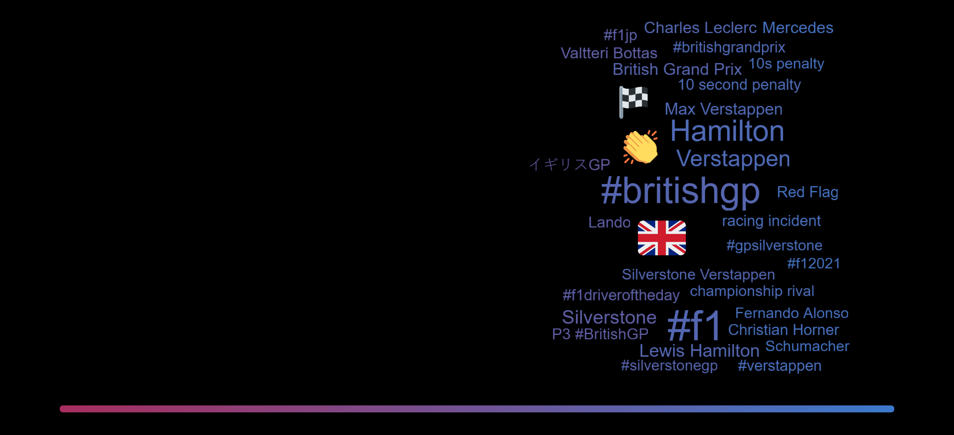
Audience Demographics | Zandvoort GP
SOCIAL ENGAGEMENT DEMOGRAPHICS
SOCIAL SENTIMENT
DEMOGRAPIC COMPARISON
AUDIENCE TOP PROFESSIONS
AUDIENCE TOP INTERESTS
Female Skew
Male Skew
Timeframe: 05/09/2021 (Race Day Only) | Sentiment & Emotional Response powered by automated analysis
Scope: Social Media (Twitter, Reddit, Forums, Tumblr) powered by Brandwatch. Traditional (Earned) Media (Online, Blogs, TV) powered by Cision Comms Cloud | “Superfan” Audience: Users with teams/drivers specifically mentioned in their profile bios – excludes organisations and journalists

Slide 8
Fan Analysis | Zandvoort GP
F1 FAN DEMOGRAPHICS (VS TWITTER AVERAGE)
TOP PROFESSIONS
MERCEDES SUPERFANS REACTION
The prevailing emotion among Mercedes fans throughout the race was sadness as Hamilton struggled to match Verstappen’s pace.
In addition, fans complained of a “boring” race, with few overtaking opportunities or on-track incidents.
+149%
+148%
+66%
+62%
+46%
TOP INTERESTS
+3911%
+480%
RED BULL SUPERFANS REACTION
Red Bull fans were vocal at the end of the race, with joy being the most prominent emotion by far. Verstappen’s home victory was celebrated broadly and dominated discussion among Red Bull fans.
Anger at 14:00 stems from reactions to Hamilton’s complaints over team radio about strategy.
-23%
-35%
-40%
GENDER SPLIT
+37%
-50%
Timeframe: 05/09/2021 (Race Day Only) | Sentiment & Emotional Response powered by automated analysis
Scope: Social Media (Twitter, Reddit, Forums, Tumblr) powered by Brandwatch. Traditional (Earned) Media (Online, Blogs, TV) powered by Cision Comms Cloud | “Superfan” Audience: Users with teams/drivers specifically mentioned in their profile bios – excludes organisations and journalists

Slide 9
Teams & Partners | Zandvoort GP
Mercedes, Ferrari and Red Bull are clearly the most visible teams at Zandvoort, with Mercedes receiving the most mentions from traditional media and Ferrari receiving the most social media discussion.
Team discussion on social media (particularly for Red Bull) is significantly lower than driver discussion, as social users focus on individual drivers over teams. This trend is less prevalent in traditional media.
Heineken leads in terms of overall partner exposure, with Pirelli leading in traditional coverage. Heineken’s dominance stems from discussion around Red Bull’s post-race afterparty with Tiesto, which the brand was tagged in extensively.
MOST VISIBLE TEAMS (TRADITIONAL & SOCIAL)
Social Mentions
Social Media Skew
TRADITIONAL MEDIA PARTNER EXPOSURE
SOCIAL MEDIA PARTNER EXPOSURE
Traditional Media Skew
Traditional Mentions
Timeframe: 05/09/2021 (Race Day Only) | Sentiment & Emotional Response powered by automated analysis
Scope: Social Media (Twitter, Reddit, Forums, Tumblr) powered by Brandwatch. Traditional (Earned) Media (Online, Blogs, TV) powered by Cision Comms Cloud | “Superfan” Audience: Users with teams/drivers specifically mentioned in their profile bios – excludes organisations and journalists

Slide 10
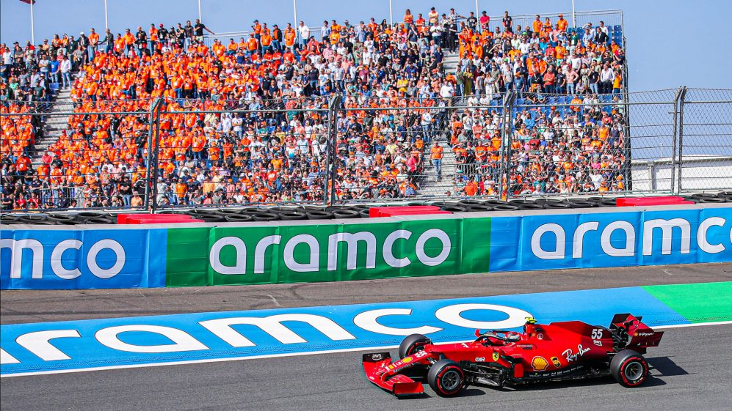
CONTACT
Concerning the report
Oli Nash
Insights Director – Automotive
oliver.nash@cision.com
Peter Wright
Account Director – Automotive
peter.wright@cision.com
MEDIA MONITORING
The Netherlands
Matthew van Riel
Sales Account Manager
matthew.vanriel@cision.com
Kelvin ter Mate
Sales Account Manager
kelvin.termate@cision.com
Belgium
Stéphanie de Munter
Sales Account Manager
stephanie.demunter@cision.com

