Slide 1
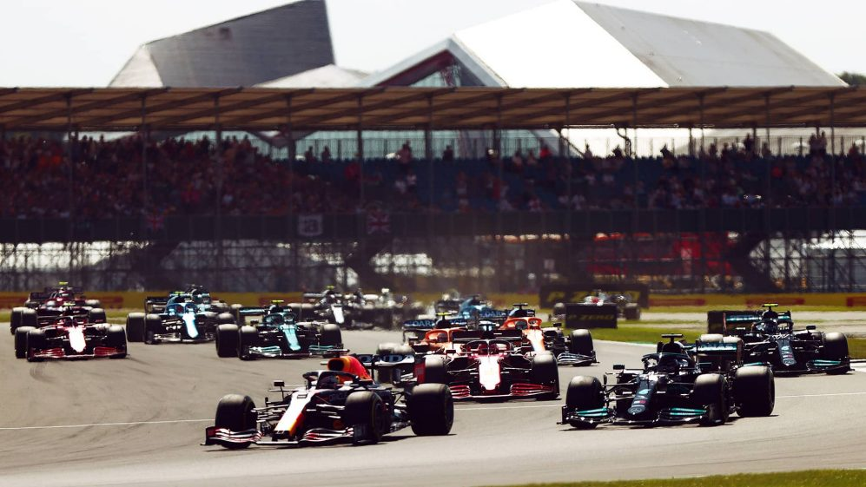

2021 SILVERSTONE GRAND PRIX
Social & Traditional Media Insights

Slide 2
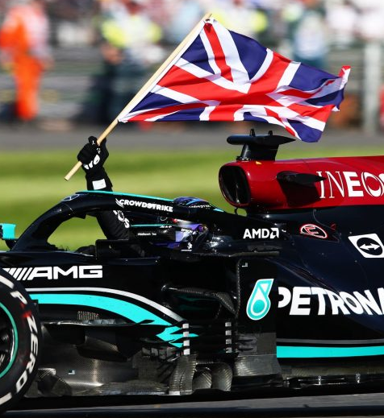

Management Summary
Silverstone was one of the most highly anticipated races of the season so far, as well as being the most visible in traditional media. On social media, it ranks second only to Hungary for total visibility.
The race was also one of the most controversial, with extremely mixed audience response on social media. A large proportion of race discussion on social media can be attributed to an incident in Lap 1 where Hamilton and Verstappen collided, ending championship leader Verstappen’s race.
While fans of Mercedes were relatively muted during the race, reacting with Joy to Mercedes’ eventual victory, other fan responses were extremely varied, with many expressing Anger over Hamilton’s 10-second time penalty and some claiming that the incident was deliberate.
Ferrari benefitted from positive exposure and audience reaction on social media after a strong race from Charles Leclerc and the driver’s first podium of the season.
The majority of news articles shared to social media were posted to Facebook, while Twitter hosted the majority of social discussion and reaction to the race. The UK produced the highest visibility at a market level, followed by the USA and Brazil.
Pirelli was the most visible partner in both traditional and social media. Heineken and Workday benefitted from significant exposure in traditional media, while Emirates, Aramco and DHL stood out in social media discussion.
17.1k | Traditional Posts
451k | Social Mentions
Hamilton
Pirelli
Most Visible Driver
Most Visible Partner
Timeframe: 01/03/2021 – 01/08/2021 | Sentiment & Emotional Response powered by automated analysis
Scope: Social Media (Twitter, Reddit, Forums, Tumblr) powered by Brandwatch. Traditional (Earned) Media (Online, Blogs, TV) powered by Cision Comms Cloud | “Superfan” Audience: Users with teams/drivers specifically mentioned in their profile bios – excludes organisations and journalists

Slide 3
F1 Season to Date
The Silverstone Grand Prix receives the highest volume of traditional media coverage in the season to date and the second-highest volume of social discussion
Anticipation is high, with traditional media spiking ahead of the race weekend, and with Practice and Qualifying sessions receiving significant levels of social engagement
As a whole, rection to the season so far has been positive on social platforms, with joy the leading emotional response in social conversation
Traditional Visibility | 1.3M | Traditional Sentiment |  | Social Visibility | 15.0M | Social Sentiment |  | Emotion
Bahrain Testing
Bahrain GP
Italy GP
Portugal GP
Spain GP
Monaco GP
Azerbaijan GP
France GP
Steier-mark GP
Austria GP
Great Britain GP
Hungary GP
Timeframe: 01/03/2021 – 01/08/2021 | Sentiment & Emotional Response powered by automated analysis
Scope: Social Media (Twitter, Reddit, Forums, Tumblr) powered by Brandwatch. Traditional (Earned) Media (Online, Blogs, TV) powered by Cision Comms Cloud | “Superfan” Audience: Users with teams/drivers specifically mentioned in their profile bios – excludes organisations and journalists

Slide 4
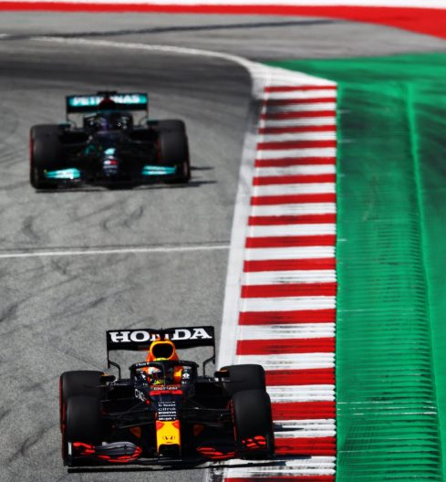
Race By Race Analysis
 | Traditional Visibility | Social Visibility | Emotion
Hungaroring | 15.9k | 543k
Silverstone | 17.1k | 451k
Baku | 12.6k | 390k
Bahrain | 12.6k | 320k
Monaco | 13.0k | 295k
Ocon wins his first race; 5-car crash in turn 1 leads to exciting, open racing with many Hamilton overtakes
Hamilton-Verstappen collision in Lap 1 leads to Max’s early retirement & victory for Lewis
Tyre malfunctions for Stroll & Verstappen; Hamilton crash after restart; Perez second win
Hamilton victory after intense final five laps closely pursued by Verstappen
Monégasque Charles Leclerc retires before race start with gearbox issues after qualifying on pole
Timeframe: 01/03/2021 – 01/08/2021 | Sentiment & Emotional Response powered by automated analysis
Scope: Social Media (Twitter, Reddit, Forums, Tumblr) powered by Brandwatch. Traditional (Earned) Media (Online, Blogs, TV) powered by Cision Comms Cloud | “Superfan” Audience: Users with teams/drivers specifically mentioned in their profile bios – excludes organisations and journalists

Slide 5

Silverstone in Focus
17.1k TRADITIONAL MENTIONS |  | 19% Positive
 |  | 18% Negative
451k SOCIAL MENTIONS |  | 22% Positive
 |  | 24% Negative
TOP MARKETS (MENTIONS)
TOP INFLUENCERS (REACH)
KEY MOMENT
LAP 1: HAM VER INCIDENT
After an intense battle from the start, Lewis Hamilton’s collision with Max Verstappen at Copse corner on Lap 1 became the number one talking point of the race.
Verstappen being forced to retire and hospitalised after the crash provoked an angry response from fans, some of whom felt that Hamilton’s 10-second penalty was too lenient, or even that the crash was strategic and purposeful.
Reactions of joy spiked later at 4pm after Hamilton won the race.
AUDIENCE RESPONSE OVER TIME
162k SOCIAL MENTIONS | 36% OF ALL SOCIAL DISCUSSION
Timeframe: 18/07/2021 (Race Day Only) | Sentiment & Emotional Response powered by automated analysis
Scope: Social Media (Twitter, Reddit, Forums, Tumblr) powered by Brandwatch. Traditional (Earned) Media (Online, Blogs, TV) powered by Cision Comms Cloud | “Superfan” Audience: Users with teams/drivers specifically mentioned in their profile bios – excludes organisations and journalists

Slide 6
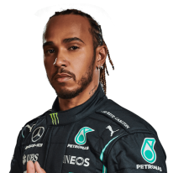
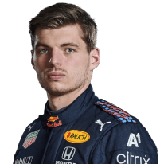
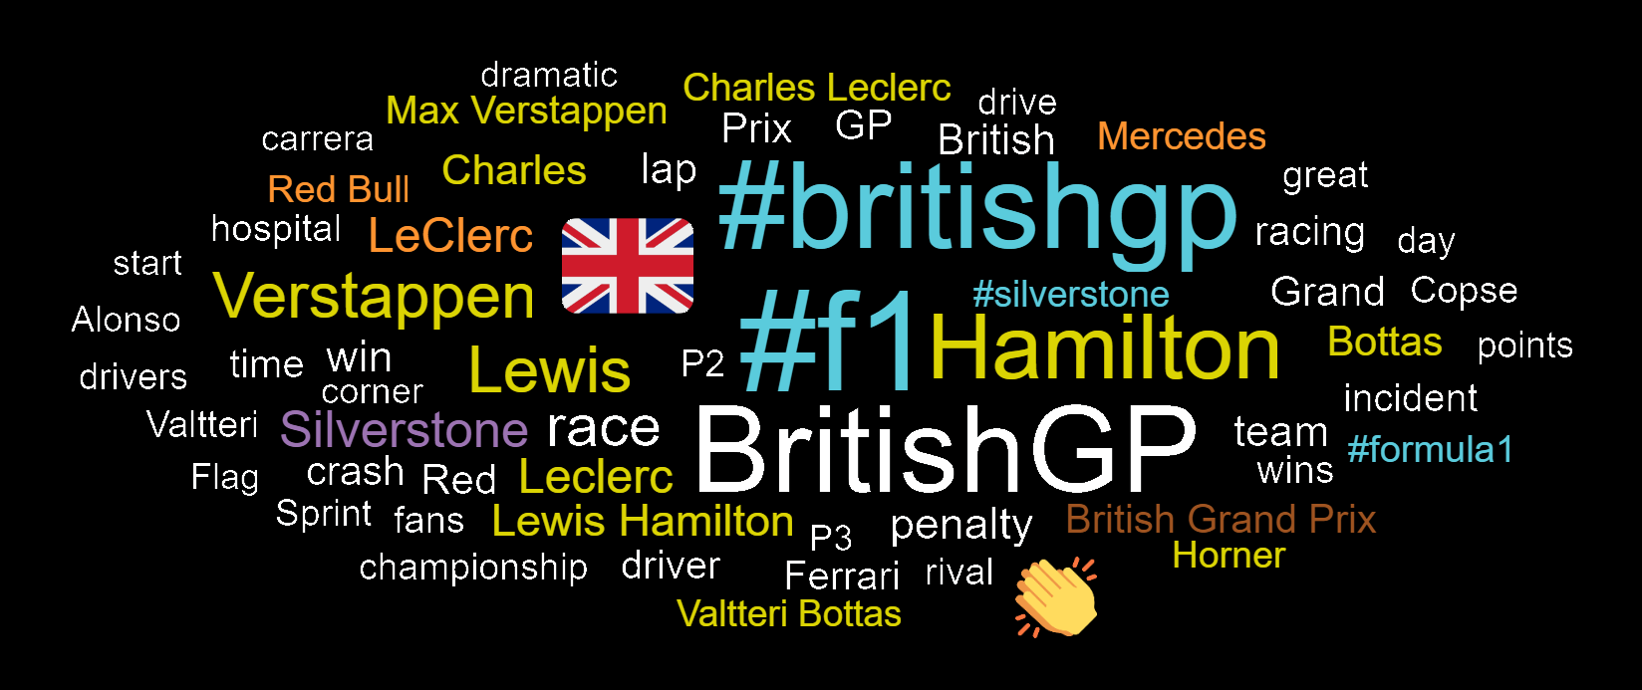
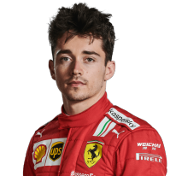
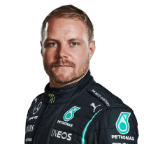
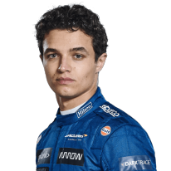
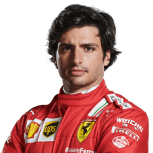
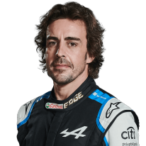
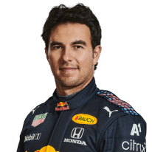
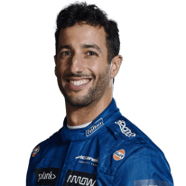
Trending Topics | Silverstone GP
As the race winner, Lewis Hamilton is by far the most discussed driver at the Silverstone GP across traditional and social media. As a British driver, his victory on home soil is referenced and celebrated across all channels.
Hamilton’s championship rivalry with Max Verstappen and the controversial incident in Lap 1 pushes the two drivers far above the rest of the pack in terms of visibility in traditional and social discussion. Emotional response around Hamilton is mixed, but Anger is especially prominent. In contrast, Sadness is the most prevalent response in discussion around Verstappen.
Charles Leclerc receives significant attention after leading for the majority of the race and scoring his first podium of the season. Joy is the most common emotional response in conversation around his race.
MOST VISIBLE DRIVERS (TRADITIONAL & SOCIAL)
Social Mentions
Social Media Skew
MOST USED KEYWORDS
Traditional Media Skew
Traditional Mentions
Timeframe: 18/07/2021 (Race Day Only) | Sentiment & Emotional Response powered by automated analysis
Scope: Social Media (Twitter, Reddit, Forums, Tumblr) powered by Brandwatch. Traditional (Earned) Media (Online, Blogs, TV) powered by Cision Comms Cloud | “Superfan” Audience: Users with teams/drivers specifically mentioned in their profile bios – excludes organisations and journalists

Slide 7
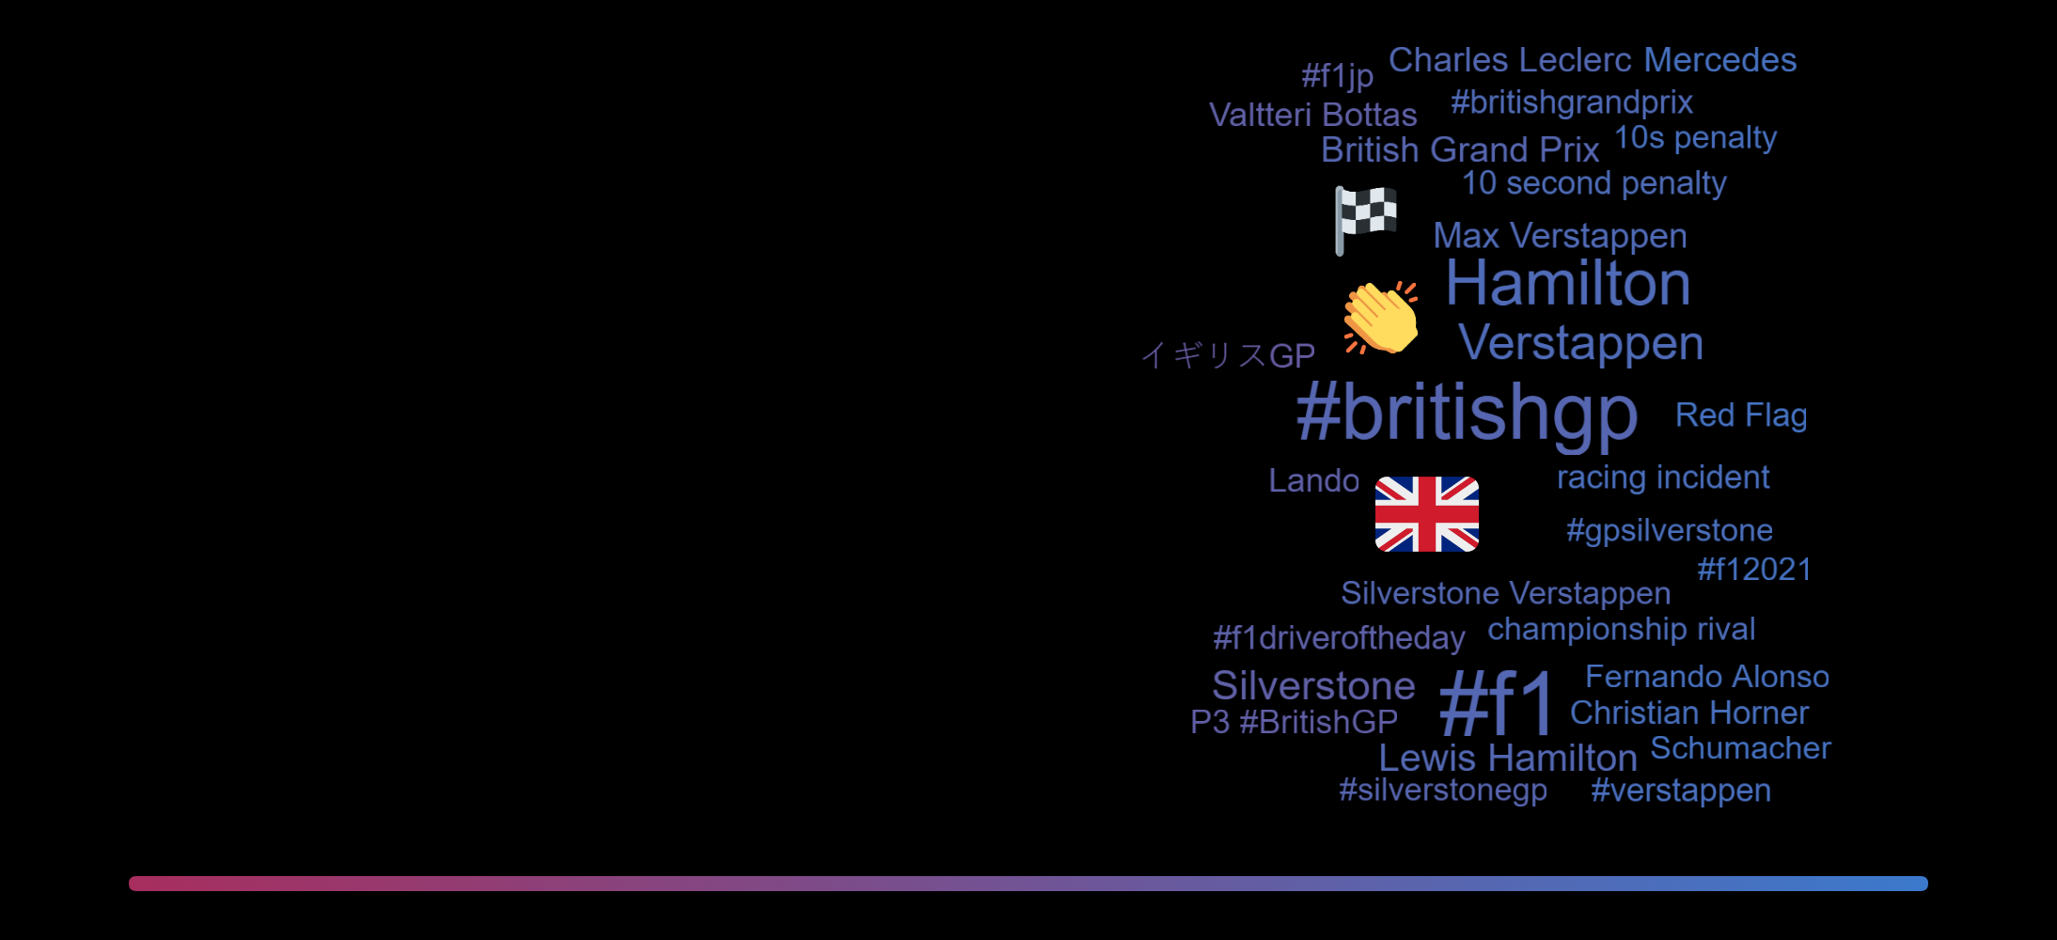
Audience Demographics | Silverstone GP
SOCIAL ENGAGEMENT DEMOGRAPHICS
SOCIAL SENTIMENT
DEMOGRAPIC COMPARISON
AUDIENCE TOP PROFESSIONS
AUDIENCE TOP INTERESTS
Female Skew
Male Skew
Timeframe: 18/07/2021 (Race Day Only) | Sentiment & Emotional Response powered by automated analysis
Scope: Social Media (Twitter, Reddit, Forums, Tumblr) powered by Brandwatch. Traditional (Earned) Media (Online, Blogs, TV) powered by Cision Comms Cloud | “Superfan” Audience: Users with teams/drivers specifically mentioned in their profile bios – excludes organisations and journalists

Slide 8
Fan Analysis | Silverstone GP
F1 FAN DEMOGRAPHICS (VS TWITTER AVERAGE)
TOP PROFESSIONS
MERCEDES SUPERFANS REACTION
Response during the race was muted from Mercedes fans, but a spike at the end of the race after Hamilton’s victory shows strong engagement overall.
Joy clearly dominates fan reaction to the race, while some Anger can be seen in response to Hamilton’s early penalty at 14:00.
+149%
+148%
+66%
+62%
+46%
TOP INTERESTS
+3911%
+480%
RED BULL SUPERFANS REACTION
Red Bull fans are vocal at the start of the race, with many tweeting about the Lap 1 incident. Response at the end of the race is mixed, with Sadness the most prevalent response.
Joy-focussed responses around Verstappen’s crash stem from seeing the driver waving to the crowd after safely leaving the vehicle.
-23%
-35%
-40%
GENDER SPLIT
+37%
-50%
Timeframe: 18/07/2021 (Race Day Only) | Sentiment & Emotional Response powered by automated analysis
Scope: Social Media (Twitter, Reddit, Forums, Tumblr) powered by Brandwatch. Traditional (Earned) Media (Online, Blogs, TV) powered by Cision Comms Cloud | “Superfan” Audience: Users with teams/drivers specifically mentioned in their profile bios – excludes organisations and journalists

Slide 9
Teams & Partners | Silverstone GP
Mercedes, Ferrari and Red Bull are clearly the most visible teams at Silverstone, with Mercedes receiving the most mentions from traditional media and Ferrari receiving the most social media discussion.
Team discussion on social media (particularly for Mercedes and Red Bull) is significantly lower than driver discussion, as social users focus on individual drivers over teams. This trend is less prevalent in traditional media.
Pirelli leads in terms of partner exposure, with Heineken seeing significant mentions in traditional coverage. On social media, partner exposure tends to be lower, but Emirates, Aramco and DHL see significantly more exposure than in traditional articles.
MOST VISIBLE TEAMS (TRADITIONAL & SOCIAL)
Social Mentions
Social Media Skew
TRADITIONAL MEDIA PARTNER EXPOSURE
SOCIAL MEDIA PARTNER EXPOSURE
Traditional Media Skew
Traditional Mentions
Timeframe: 18/07/2021 (Race Day Only) | Sentiment & Emotional Response powered by automated analysis
Scope: Social Media (Twitter, Reddit, Forums, Tumblr) powered by Brandwatch. Traditional (Earned) Media (Online, Blogs, TV) powered by Cision Comms Cloud | “Superfan” Audience: Users with teams/drivers specifically mentioned in their profile bios – excludes organisations and journalists

Slide 10
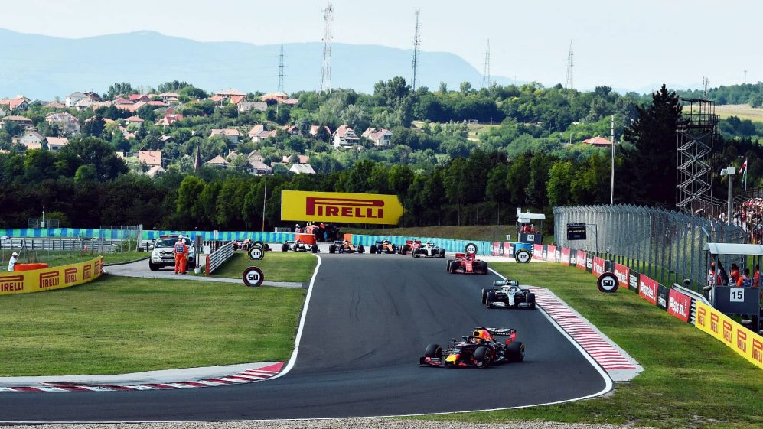
CONTACT
Oli Nash
Insights Director – Automotive
oliver.nash@cision.com
Peter Wright
Account Director – Automotive
peter.wright@cision.com

